Slide 1
PIP4004 - INTERNSHIP Final Viva Voce Presentation CORMSQUARE SUPPORT HUB: CENTRALIZED KNOWLEDGE & SOLUTIONS
Student Details
Name | MEDHA JEENOOR
Roll No | 20211CSE0209
Section | 8COM/CSE04-SEC15
Batch No. | NA
Under the Supervision of
Dr. Sandeep Albert Mathias
Assistant Professor
School of Computer Science and Engineering
Presidency University
Name of the Program: CSE
Name of the HoD: Dr. Asif Mohammed H.B
Name of the Program Project Coordinator: Mr. Amarnath J.L & Dr. Jayanthi. K
Name of the School Internship/Project Coordinators: Mr. Md Ziaur Rahman /
Dr. Sampath A K

Slide 2
Content
About Company or Organization
Working domain or the technology
About your team and reporting Manager
Challenges Faced in Internship
Objectives of the work
Literature Review
Proposed System
Problem Statement
System Requirements
Advantages of Proposed System/Work
Internship Roadmap
Github Link

Slide 3
Company Overview
Introduction to CormSquare
CormSquare is a technology company specializing in procurement and supply chain solutions.
Headquartered in Bengaluru, India.
Mission and Vision
Aims to transform procurement processes through automation, collaboration, and advanced analytics
Website: https://cormsquare.com/
Notes:
CormSquare is a procurement and supply chain technology company based in Bengaluru, India. Their primary goal is to simplify and automate procurement processes for businesses, helping them improve efficiency, reduce costs, and enhance supplier relationships.
The company's mission is to enhance procurement operations by leveraging automation, collaboration, and advanced analytics. This means that instead of traditional, manual procurement processes (which can be slow and error-prone), CormSquare provides digital solutions that make procurement faster, more transparent, and more efficient.

Slide 4
Product Offerings
Multi-Enterprise Supply Chain Network
Enhances visibility and collaboration across organizational boundaries.
eProcurement Solutions
Offers a procure-to-pay (P2P) suite, including eInvoice and eSettlement functionalities.
Spend Management Solutions
Provides in-transaction analytics integrated with eProcurement to optimize spending.
Contract Compliance Management
Ensures service obligations are met, verifies invoices against contracts, and improves governance.
Notes:
CormSquare offers a range of solutions that help businesses streamline procurement, manage supply chains, and control spending. Here’s a breakdown:
Multi-Enterprise Supply Chain Network
This solution helps businesses collaborate with suppliers and partners in real-time to improve supply chain visibility and reduce inefficiencies.
eProcurement Solutions (Procure-to-Pay Suite)
This includes tools like eInvoice and eSettlement, which help organizations automate their purchasing process from order creation to final payment, making everything seamless and paperless.
Spend Management Solutions
By using real-time analytics, companies can track and control their expenses while procuring goods or services, helping them reduce wasteful spending.
Contract Compliance Management
This feature ensures that vendors and suppliers adhere to contract terms, helping businesses avoid financial risks and legal disputes.

Slide 5
Client Testimonials
Leading Technology Company
Achieved a fully automated and paperless platform, reducing supplier registration and procurement cycle times.
Neyo Group
Praised the quick deployment and comprehensive audit trail of the procure-to-pay and order processing suite.
V3 Group
Utilizes the sourcing suite to maintain tight control over procurement operations.
XFERS
Benefits from improved supply chain control and reporting through the Multi-Enterprise solution.
Notes:
CormSquare has successfully worked with various companies to improve their procurement and supply chain processes. Here are some real-world examples:
A Leading Technology Company
They implemented CormSquare’s solutions to go completely paperless, reducing supplier registration time and speeding up procurement.
Neyo Group
This company benefited from quick deployment of the platform and a detailed audit trail, ensuring transparency and accountability in procurement.
V3 Group
They used CormSquare’s sourcing suite to maintain strict control over procurement, preventing errors and unauthorized spending.
XFERS
This company improved its supply chain monitoring and reporting with CormSquare’s Multi-Enterprise solution, leading to better decision-making.

Slide 6
Working domain or the technology
Assigned Domain: Development
Technologies Used:
Front-End: HTML, CSS, JavaScript, JQuery
Back-End: Microsoft .NET
Database: SQL Server

Slide 7
About your team and reporting Manager
Product Team
Gather requirements
Development Team
Develop application & requirements
Testing Team
Test application and requirements
Technical Lead
Darshan D M, Reporting Manager
CormSquare
Cormorant Engineering India Pvt. Ltd.

Slide 8
Challenges Faced in Internship
Adapting to the company work culture
Learning the technologies used by the company
Getting adjusted with the team

Slide 9
Objectives of the work
Continuously adapting to the new technologies.
Increasing the efficiency of an ongoing project by developing the working model to a problem faced.

Slide 10
Literature Review
Implementing Atlassian Confluence: Strategies, tips, and insights to enhance distributed team collaboration using Confluence
Implementation of controls for insertion of accessible images in open online editors based on WCAG guidelines. Case studies: TinyMCE and Summernote
TipTap Editor
Oracle Knowledge Support
Paste image from clipboard using javascript in ckeditor, Book: Advances in Computer Science and its Applications
Editor.js
Professional Node. js: Building Javascript based scalable software
SyncFusion Rich Text Editor
Quill: An extensible system for editing documents of mixed type, Book title: Proceedings of the Twenty-First Annual Hawaii International Conference on System Sciences. Volume II: Software track
Amazon Contact Us Services

Slide 11
Proposed System / Work
Existing Issues:
Lack of a centralized system for managing knowledge.
Employees spend too much time searching for solutions.
Need for a Solution:
A structured Knowledge Management System (KMS) to organize and retrieve information efficiently.
Role-based access for employees, admins, and external users.

Slide 12
Problem Statement
CormSquare Support Hub: Centralized Knowledge & Solutions
Functional Requirements:
User Management: Admin, KM Creators, KM Champions, External Users
Knowledge Base: FAQs, How-To Guides, Technical Solutions, RCA Templates
Trending System: Based on views and usage frequency
Approval Workflow: KM Champions review & approve content before publishing

Slide 13
Methodology - System Flow & User Interaction
1. User Flow:
Login/Register:
Internal users log in directly.
External users register and await admin approval.
Search & Request Info:
Users search solutions. If found → View & Upvote.
If not found → Request Info → Submit Form (stored in My Requests & Issues).
Issue Resolution:
KM Creators create solutions for issues using category-based templates.
Submit solution → Sent to KM Champions for review.
2. Approval Process:
KM Champions:
Review solutions → Approve, Reject, or Request Changes.
Approved solutions are published and listed in Published Solutions.

Slide 14
Methodology - Admin Role & Template Management
Admin Responsibilities:
User Management:
Approves external user registrations.
Creates and manages internal users.
Manages existing users (update, delete).
Template Management:
Creates templates for each category and product.
Updates templates dynamically based on category selection.

Slide 15
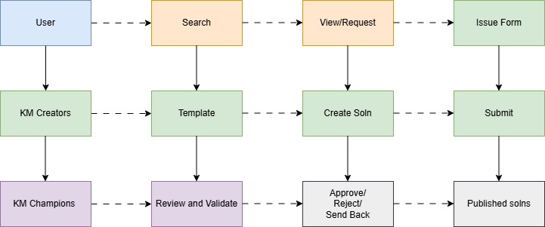
Architecture - User Flow and Interaction

Slide 16
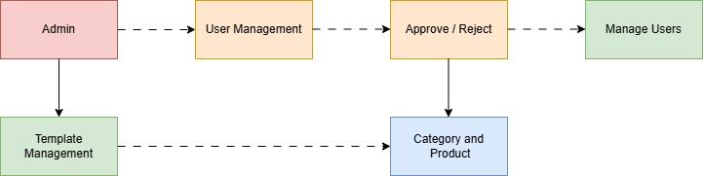
Architecture – Admin Role & Management

Slide 17
System Requirements
Software Requirements:
Front-End: HTML, CSS, JavaScript, Bootstrap, jQuery
Back-End: .NET Framework, C#
Database: SQL Server
Hardware Requirements:
Minimum 8GB RAM, Core i5 Processor, Windows 10+
Microsoft SQL Server for database storage

Slide 18
Advantages of Proposed System/Work
Centralized Knowledge Management – One place for all documentation.
Quick Access & Searchability – Reduces time spent on searching for information.
Role-Based Access – Ensures proper content control.
Scalability – Can be expanded with more features in the future.
Improved Decision-Making – Easy access to critical knowledge for employees.
Real-Time Updates – Keeps the knowledge base up-to-date with minimal effort.

Slide 19
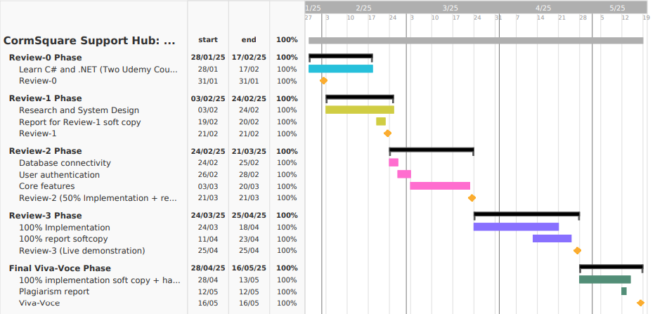
Internship Road Map

Slide 20
Outcomes
Improved Knowledge Accessibility
Faster retrieval of relevant solutions with search and filter options.
Enhanced collaboration between distributed teams through a centralized platform.
Streamlined Solution Creation & Review
Simplified process for KM Creators to draft and submit solutions.
Effective moderation by KM Champions ensures quality content.
Secure & Controlled Access
External users require admin approval, ensuring system security.
Internal users can manage templates and maintain content consistency.
Increased Operational Efficiency
Reduced resolution time for raised issues.
Better knowledge retention and continuous process improvement.

Slide 21
Conclusion
The implementation of the CormSquare Support Hub enhances knowledge management by streamlining the submission, review, and publishing of solutions.
User-friendly Interface: Enables seamless search, solution creation, and issue tracking for both internal and external users.
Efficient Workflow: KM Creators and KM Champions ensure solutions are reviewed and published effectively.
Admin Oversight: Manages templates, categories, and user approvals, maintaining a controlled environment.

Slide 22
Github Link
https://github.com/MedhaJeenoor/CormSquare-Development-Internship

Slide 23
References
Kalelioğlu, Eren. Implementing Atlassian Confluence: Strategies, tips, and insights to enhance distributed team collaboration using Confluence. Packt Publishing Ltd, 2023.
Sanchez-Gordon, Sandra, Tania Calle-Jimenez, Jorge Villarroel-Ramos, Janio Jadán-Guerrero, César Guevara, Patricio Lara-Alvarez, Patricia Acosta-Vargas, and Luis Salvador-Ullauri. "Implementation of controls for insertion of accessible images in open online editors based on WCAG guidelines. Case studies: TinyMCE and Summernote." In Advances in Human Factors and Systems Interaction: Proceedings of the AHFE 2019 International Conference on Human Factors and Systems Interaction, July 24-28, 2019, Washington DC, USA 10, pp. 315-326. Springer International Publishing, 2020.
https://github.com/ueberdosis/tiptap
https://support.oracle.com/knowledge/Oracle%20Linux%20and%20Virtualization/2216441_1.html
Zhang, Baoming, and Man Ren. "Paste image from clipboard using javascript in ckeditor." Advances in Computer Science and its Applications 1, no. 4 (2012): 240-243.
https://github.com/codex-team/editor.js
Teixeira, Pedro. Professional Node. js: Building Javascript based scalable software. John Wiley & Sons, 2012.

Slide 24
References
https://www.syncfusion.com/aspnet-core-ui-controls/wysiwyg-rich-text-editor
Chamberlin, Donald D., Helmut F. Hasselmeier, Allen W. Luniewski, Dieter P. Paris, Bradford W. Wade, and Mitch L. Zolliker. "Quill: An extensible system for editing documents of mixed type." In Proceedings of the Twenty-First Annual Hawaii International Conference on System Sciences. Volume II: Software track, vol. 2, pp. 317-318. IEEE Computer Society, 1988.
https://www.amazon.com/s?k=how+to+contact+you&crid=1W4UO6BPX8C67&sprefix=how+to+contact+you%2Caps%2C300&ref=nb_sb_noss_1

Slide 25

Project work mapping with SDG
SDG 9 – Industry, Innovation & Infrastructure
Supports SDG 9 by building resilient digital infrastructure for knowledge sharing and innovation.
Structured Platform: Centralized storage and reuse of solutions, documentation, and FAQs.
Modern Technologies: Uses TinyMCE, SQL Server full-text search, and Chart.js for efficiency and innovation.
Role-Based Workflow: Ensures governance and collaboration through KM Creators, Champions, and Admins.
Fosters Innovation: Encourages continuous knowledge improvement and operational excellence.

Slide 26
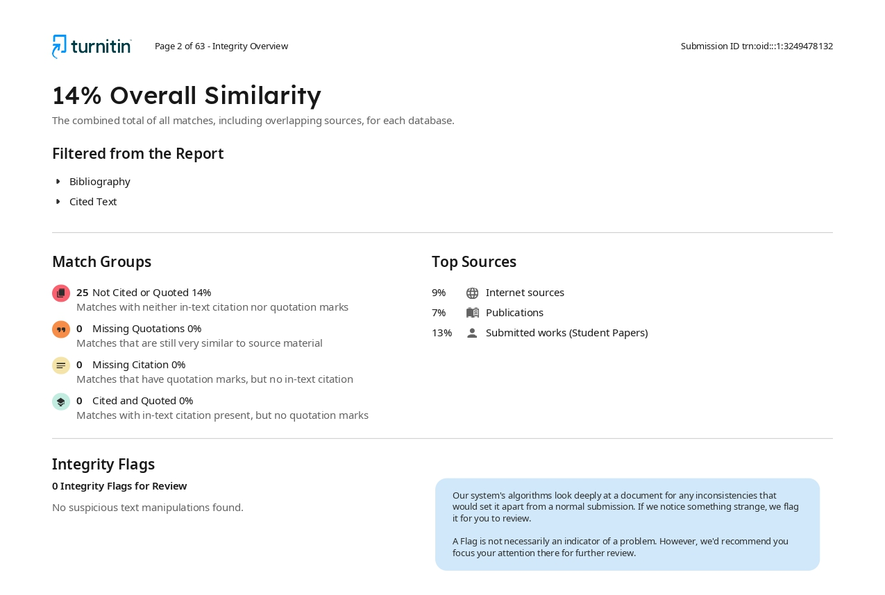
Similarity Index

Slide 27
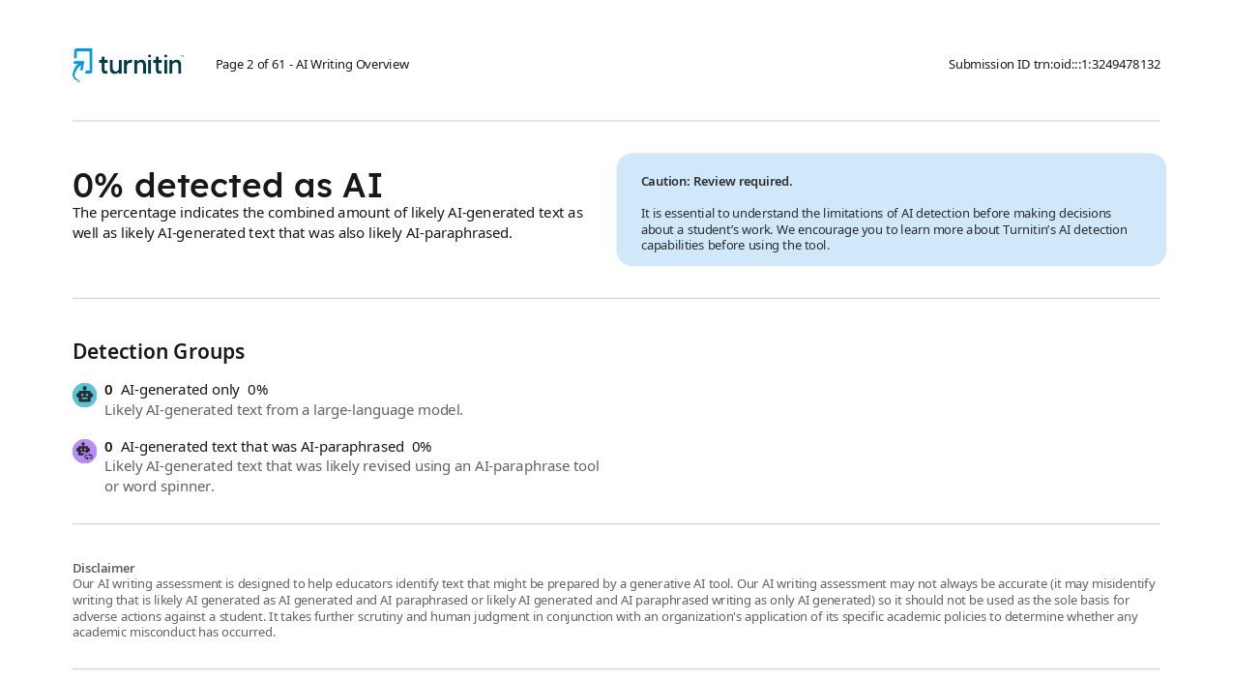
AI Check

Slide 28
Q&A

Slide 29
Thank you !!

